Slide 1
Articulating Obsolescence
in a Broken World Way
Jina Chang • The National Museum, Norway • 06.12.2019

Slide 2
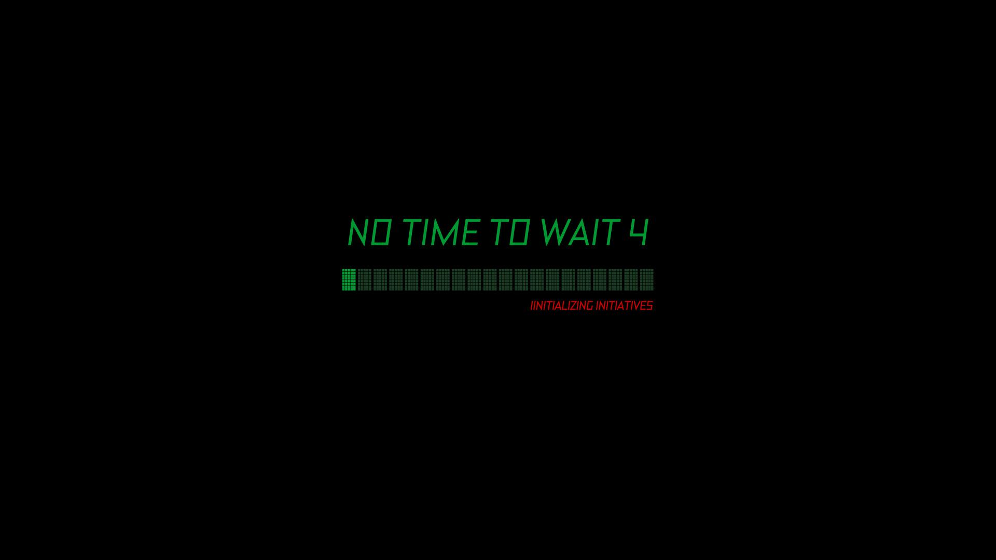

Slide 3
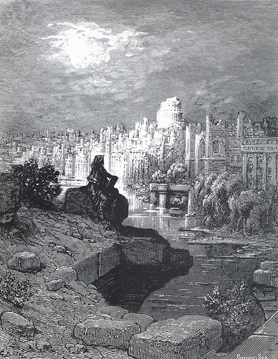
Now we have watched the fleets into noisy Billingsgate; and now gossiped looking towards Wren's grand dome, shaping Macaulay's dream of the far future, with the tourist New Zealander upon the broken parapets, contemplating something matching - The glory that was Greece - The grandeur that was Rome.
- Blanchard Jerrold (ed), London: a Pilgrimage (1872)
Gustave Doré, The New Zealander (1872)

Slide 4
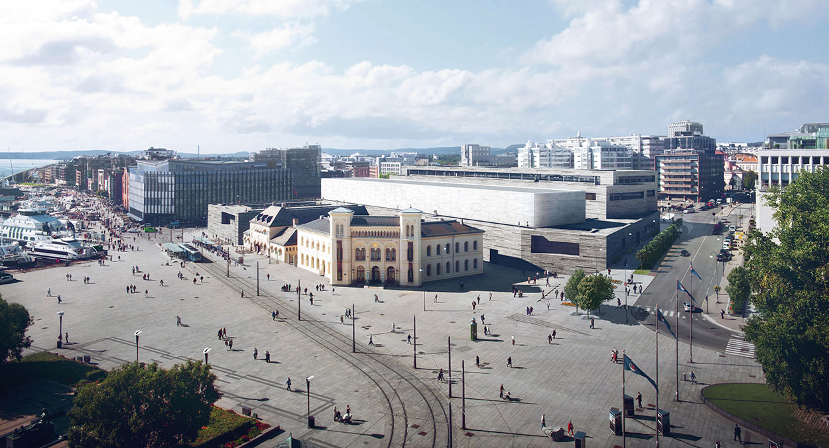

Slide 5
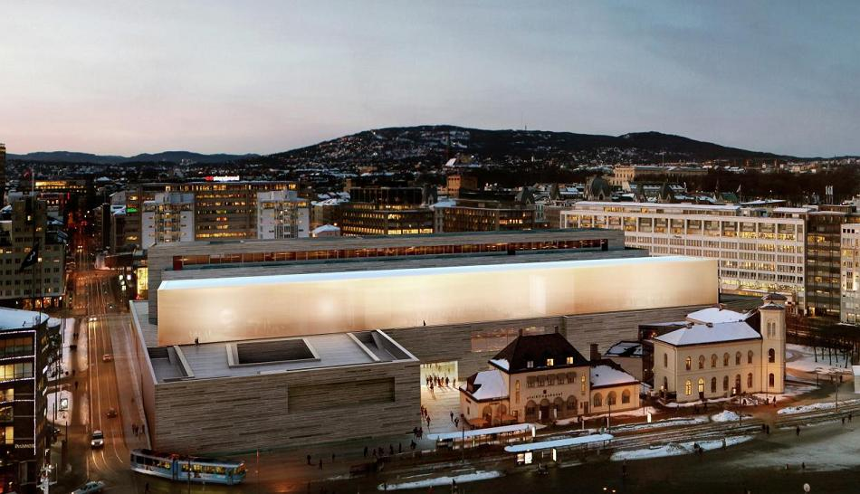

Slide 6
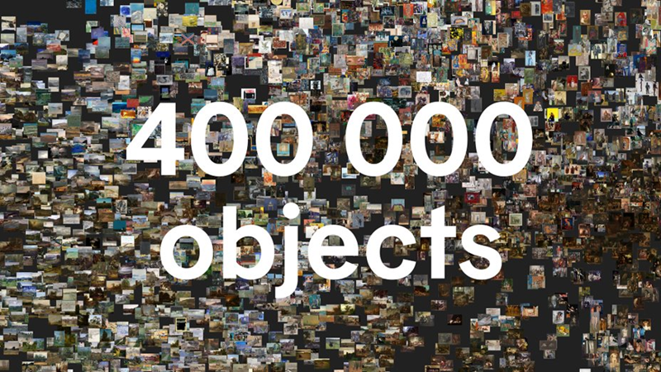

Slide 7
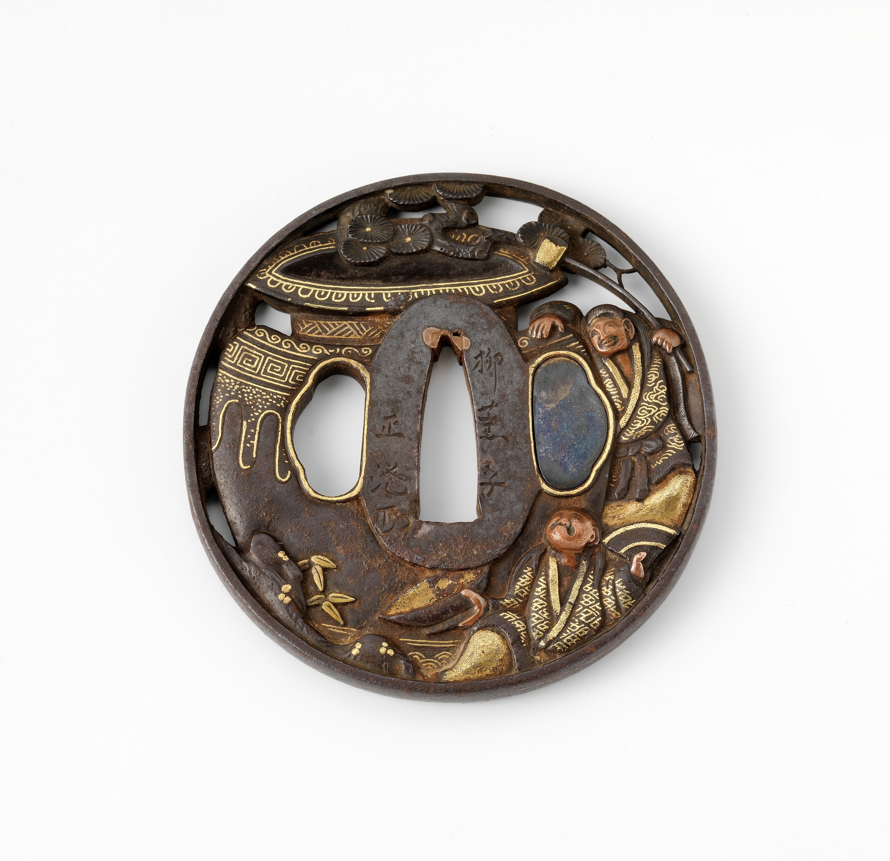
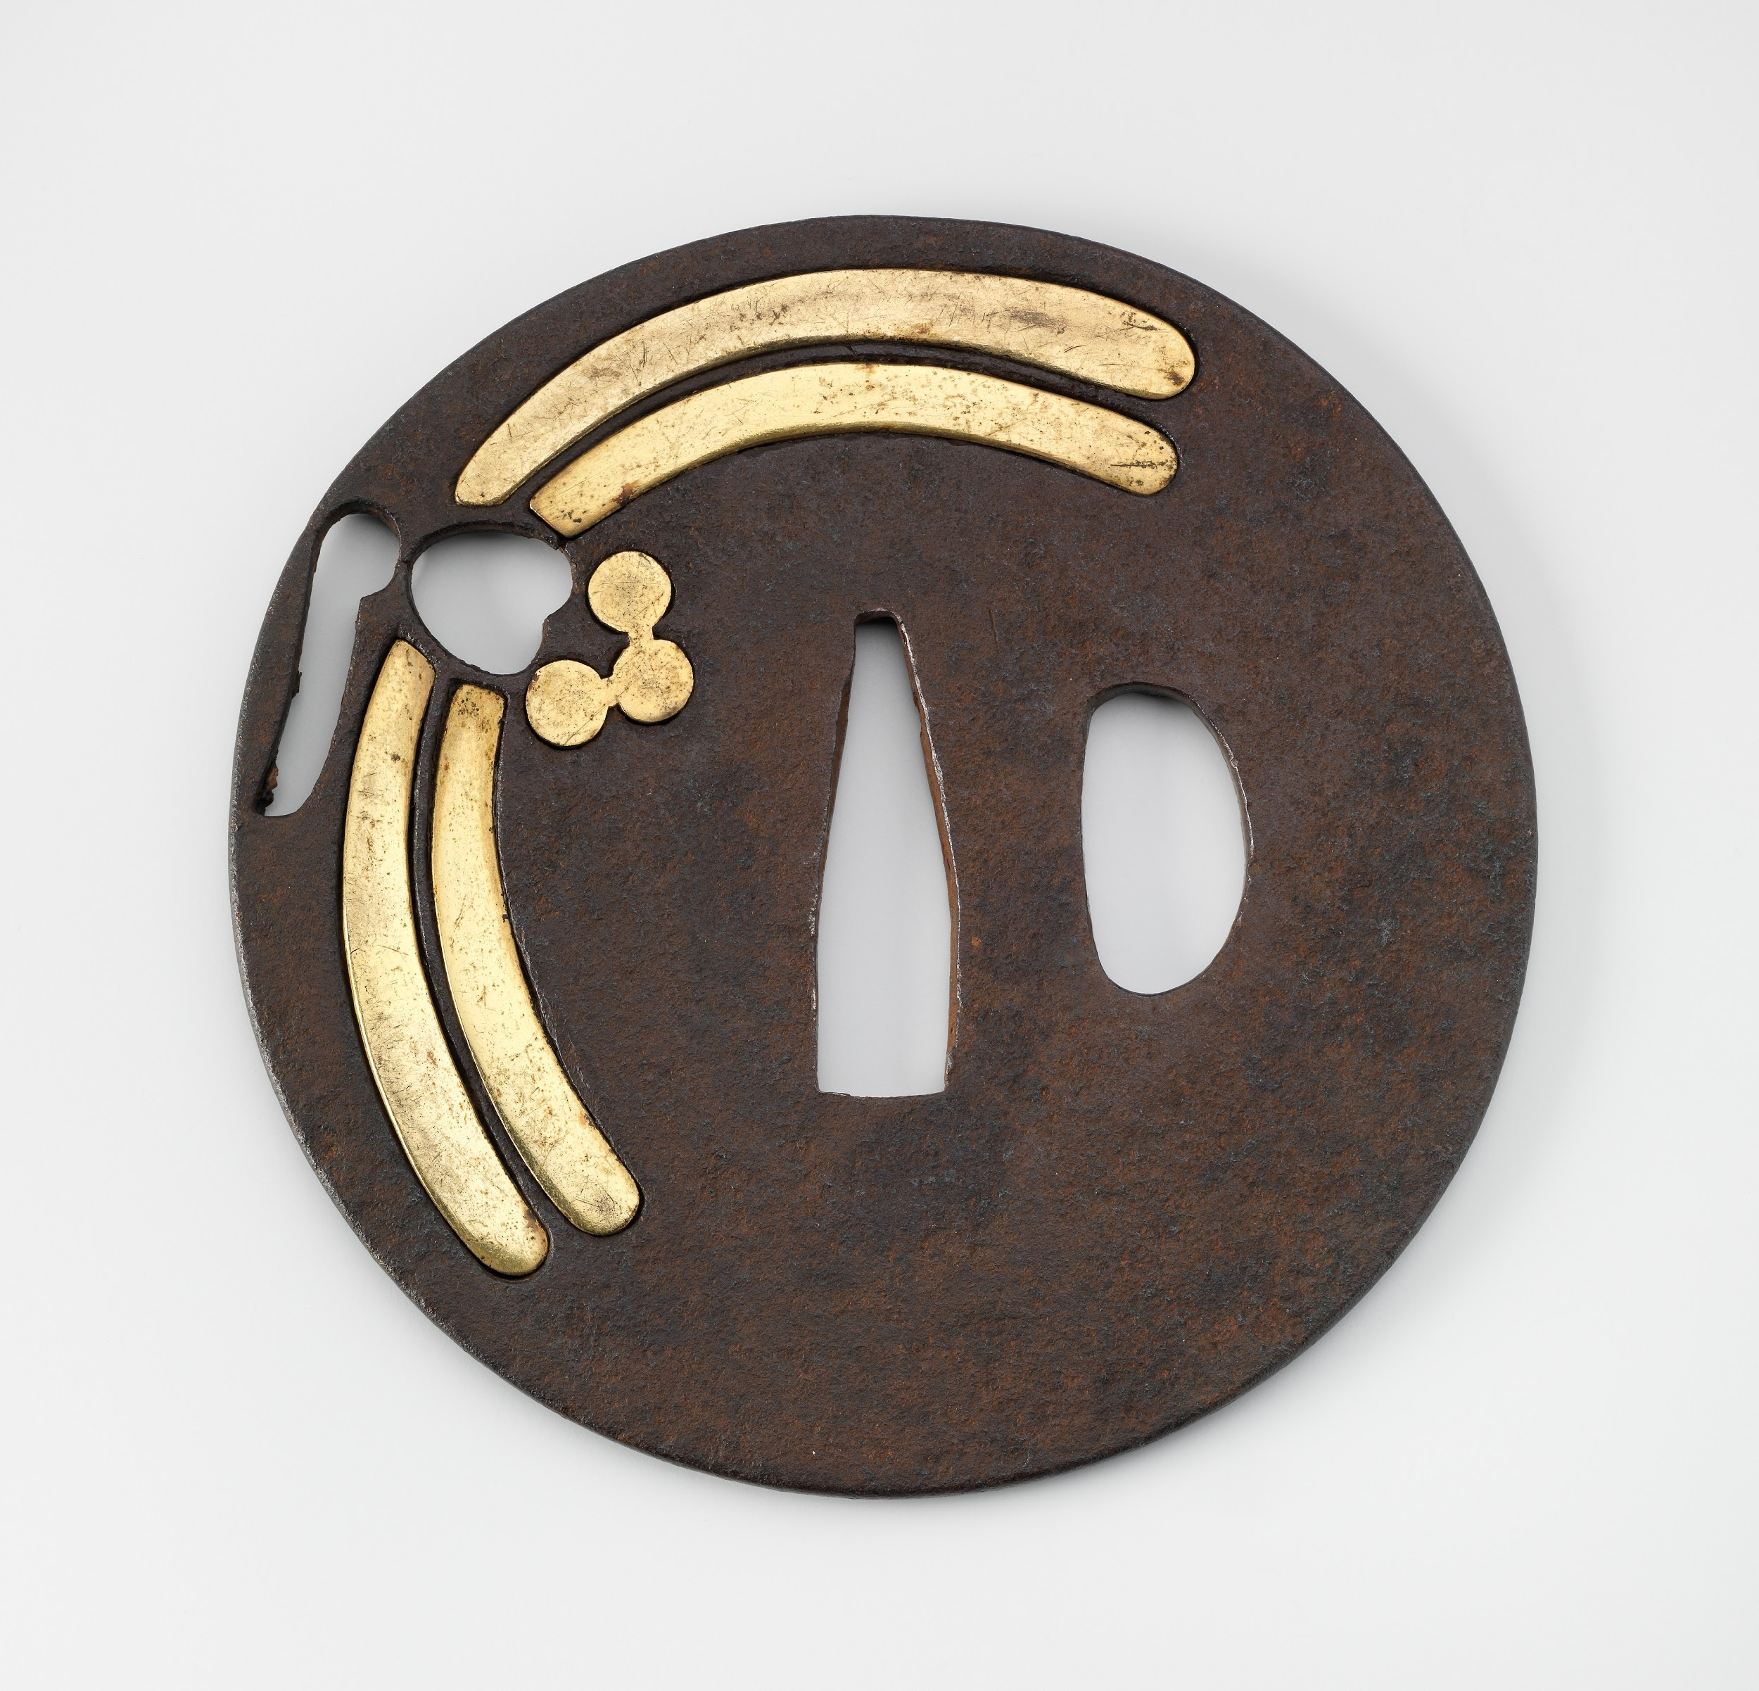
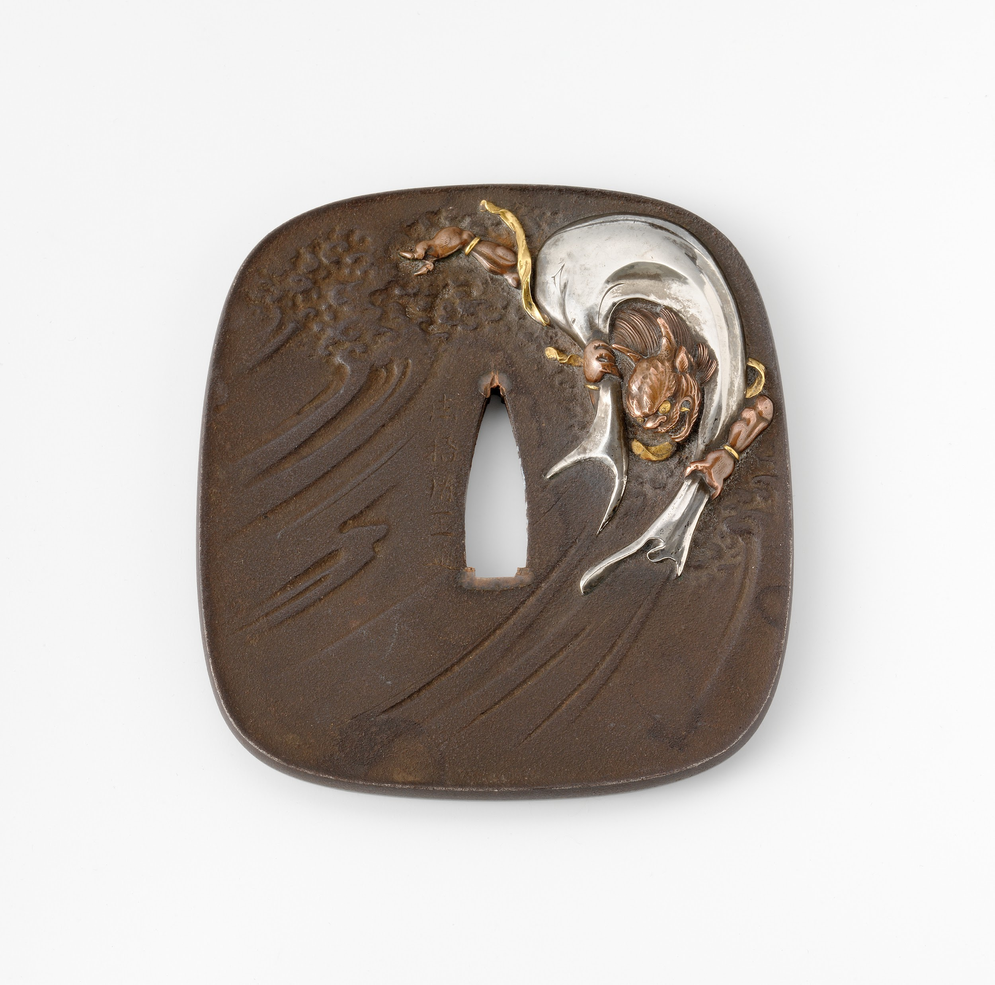

Slide 8
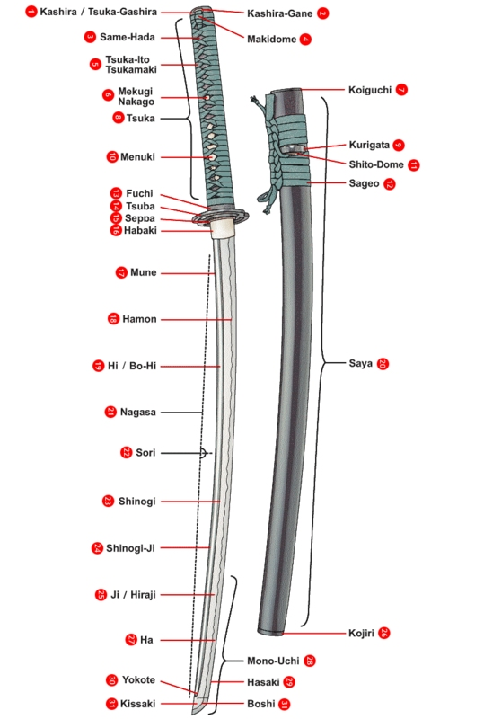

Slide 9
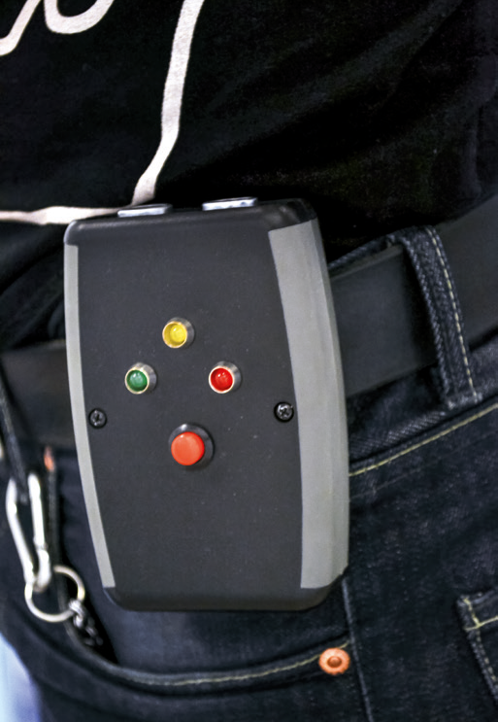
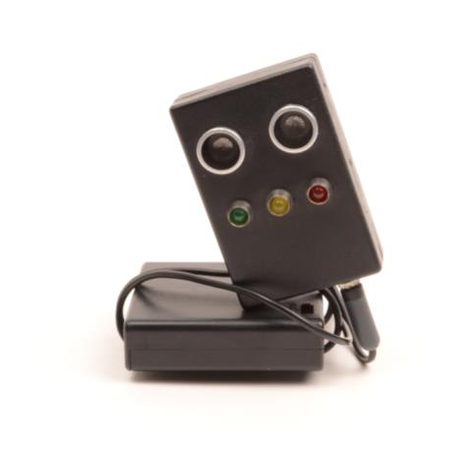
Emil Gustaffson, Sosial avstandmåler (2015)

Slide 10
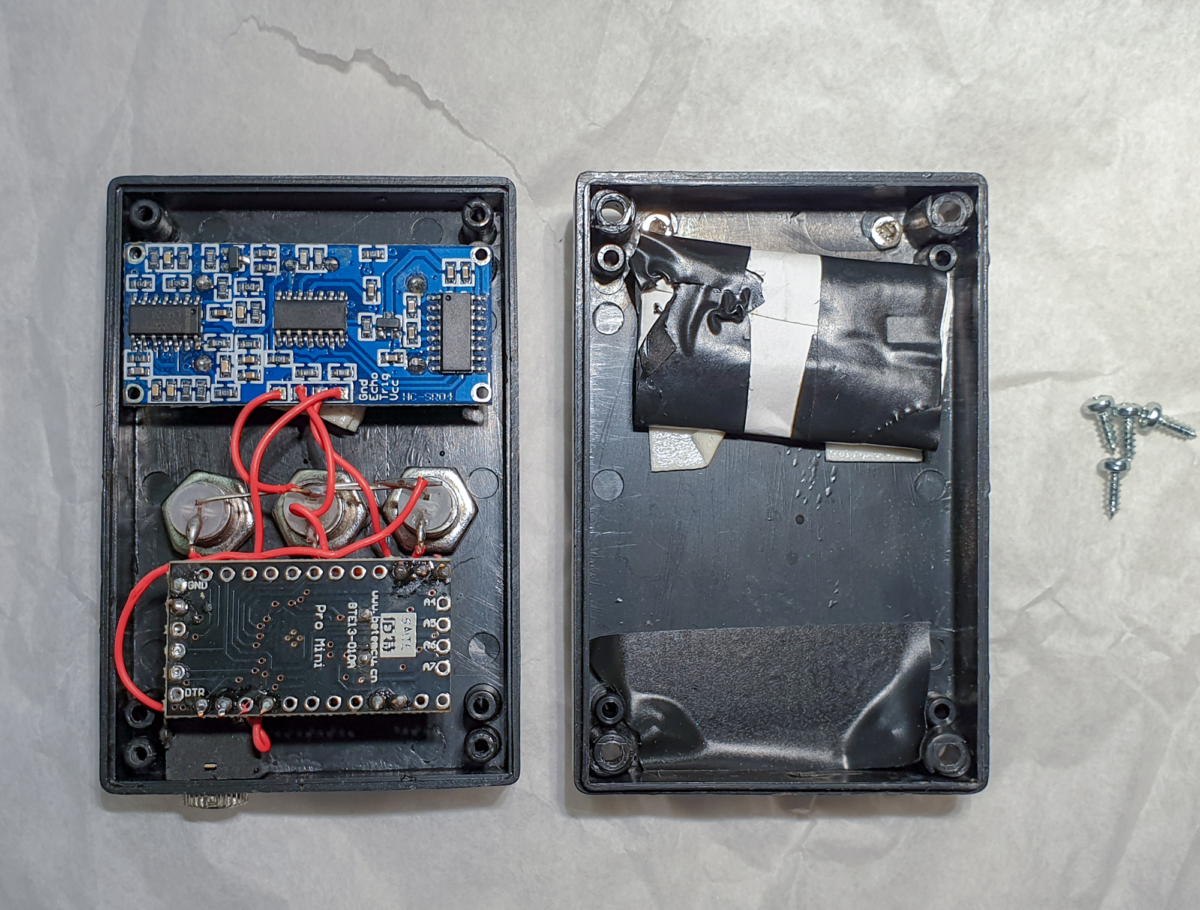
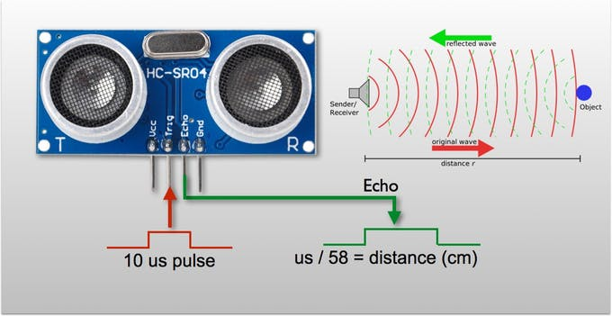
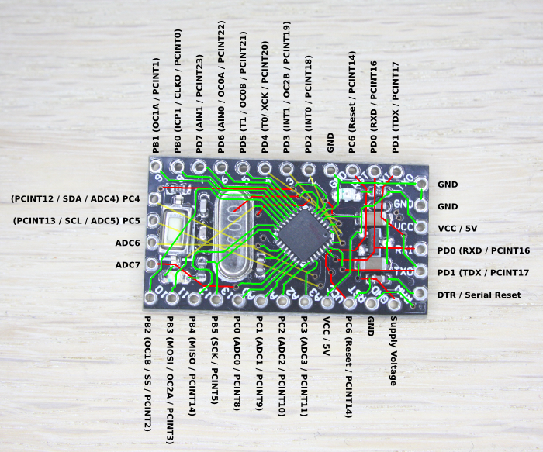

Slide 11
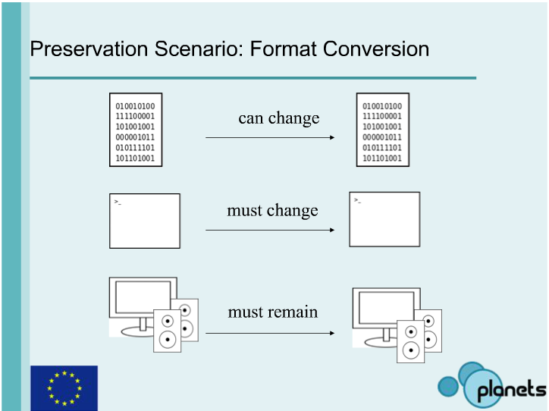
3 Aspects of Digital Content
The content file
The software to interpret the content files (processing)
The hardware that displays the content (representation)
http://www.planets-project.eu/training-materials/4-schnasse-understanding_files/

Slide 12
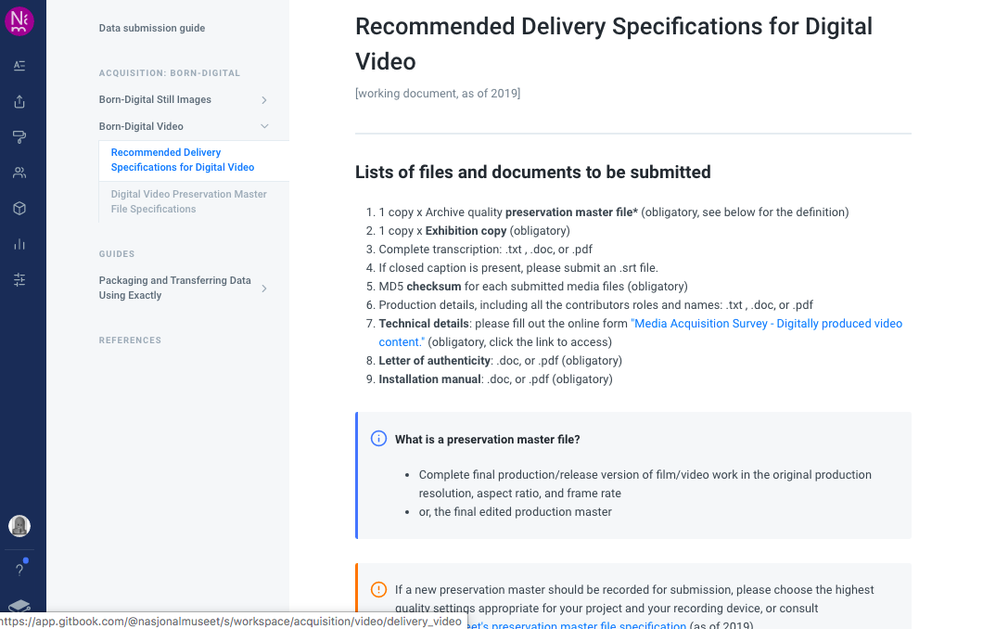

Slide 13
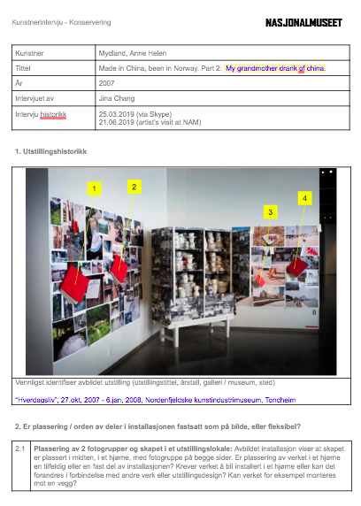
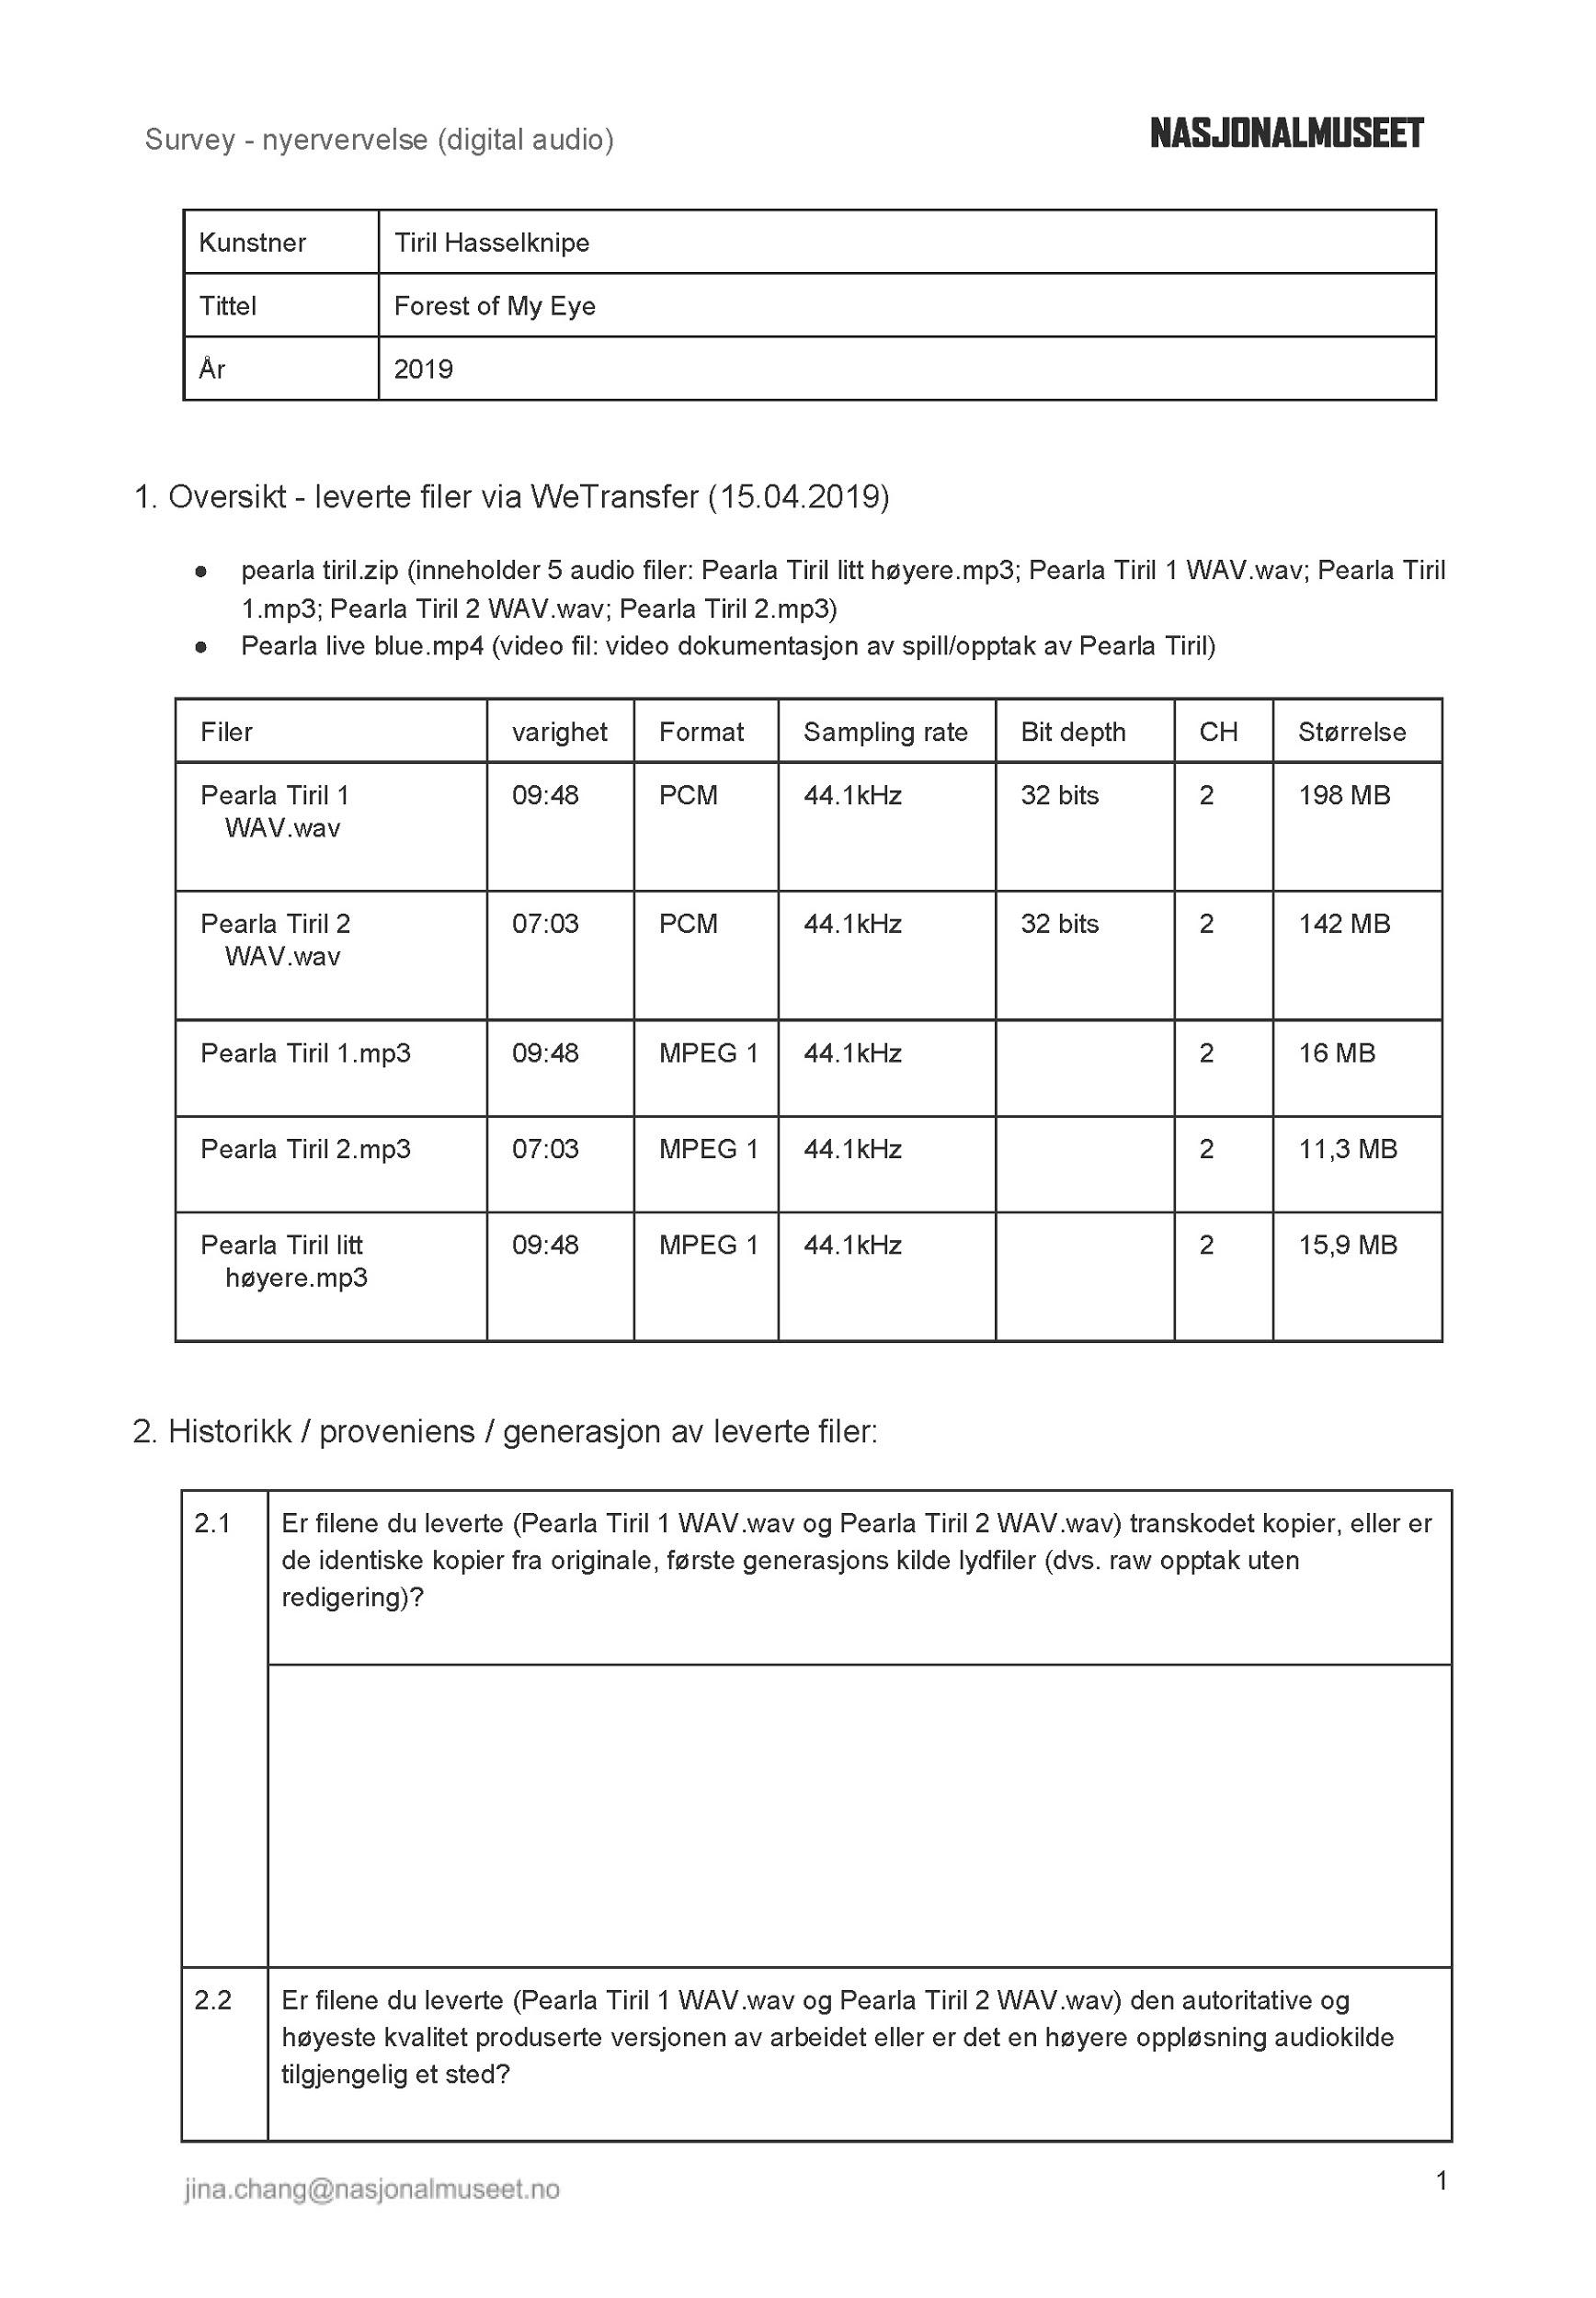

Slide 15
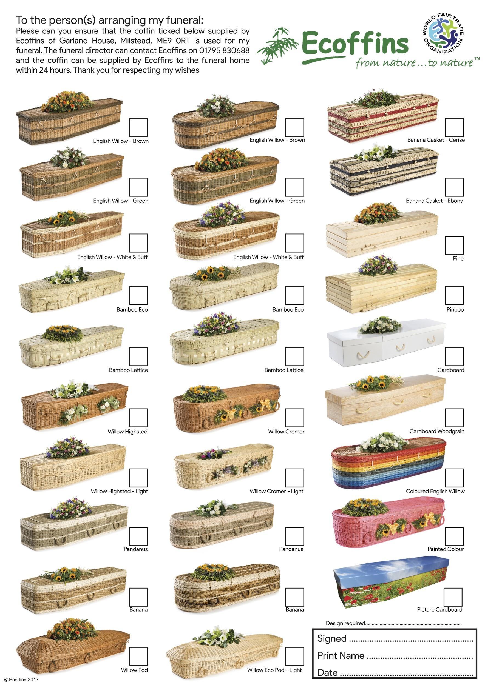
https://www.ecoffins.co.uk/

Slide 16
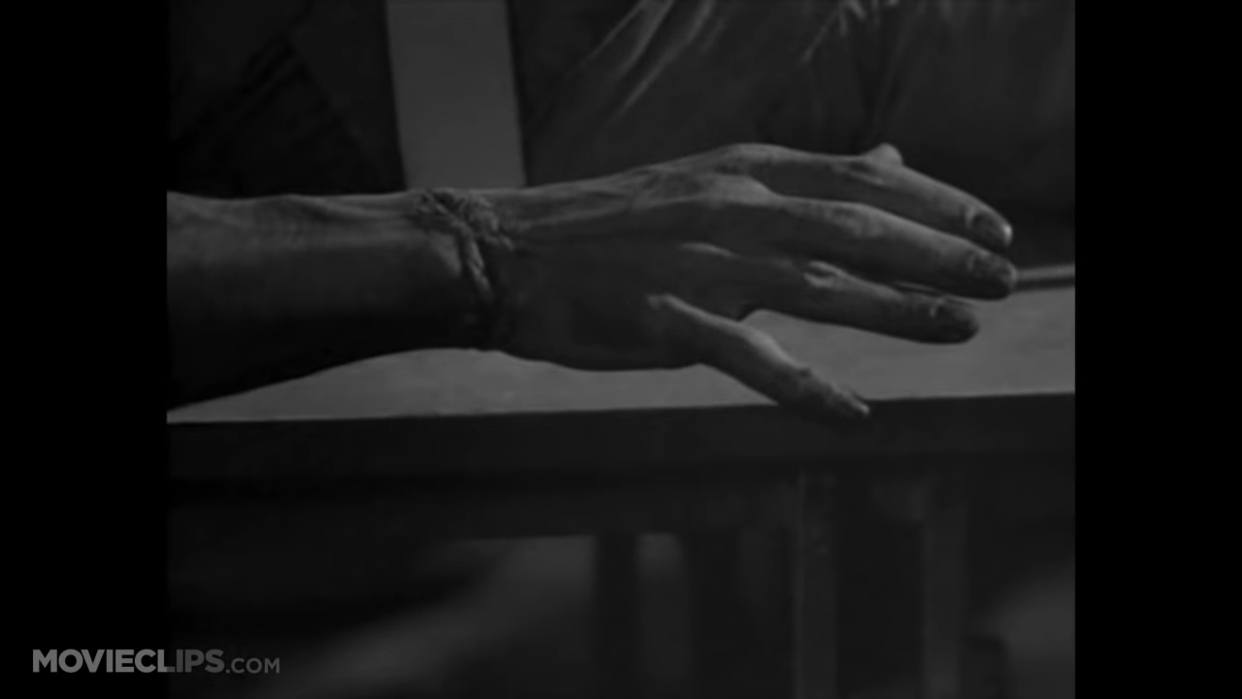
Frankenstein (1931)

Slide 17
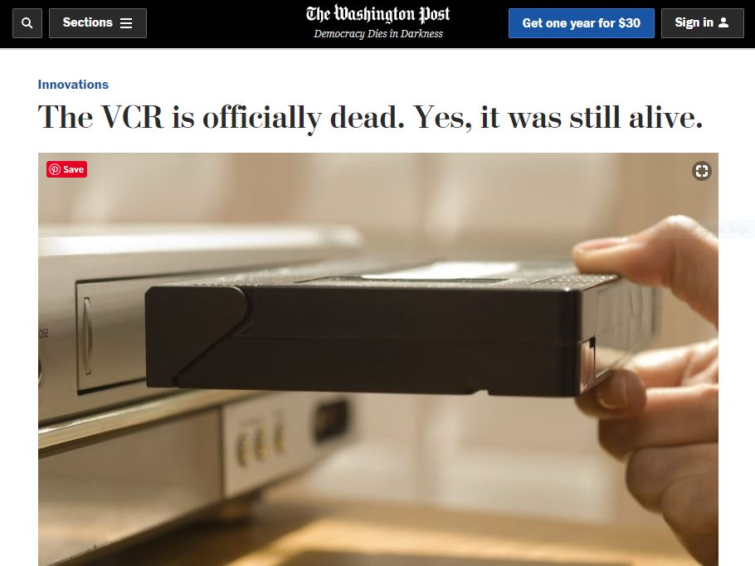
https://www.washingtonpost.com/news/innovations/wp/2016/07/22/rip-to-the-vcr/

Slide 18
§ 108. Limitations on exclusive rights: Reproduction by libraries and archives
(c) The right of reproduction under this section applies to three copies or phonorecords of a published work duplicated solely for the purpose of replacement of a copy or phonorecord that is damaged, deteriorating, lost, or stolen, or if the existing format in which the work is stored has become obsolete, if—
(1) the library or archives has, after a reasonable effort, determined that an unused replacement cannot be obtained at a fair price; and
(2) any such copy or phonorecord that is reproduced in digital format is not made available to the public in that format outside the premises of the library or archives in lawful possession of such copy.
For purposes of this subsection, a format shall be considered obsolete if the machine or device necessary to render perceptible a work stored in that format is no longer manufactured or is no longer reasonably available in the commercial marketplace.
Notes:
https://tisch.nyu.edu/cinema-studies/miap/research-outreach/research/video-at-risk.html
VIDEO AT RISK
Video at Risk: Strategies for Preserving Commercial Video Collections in Research Libraries

Slide 19
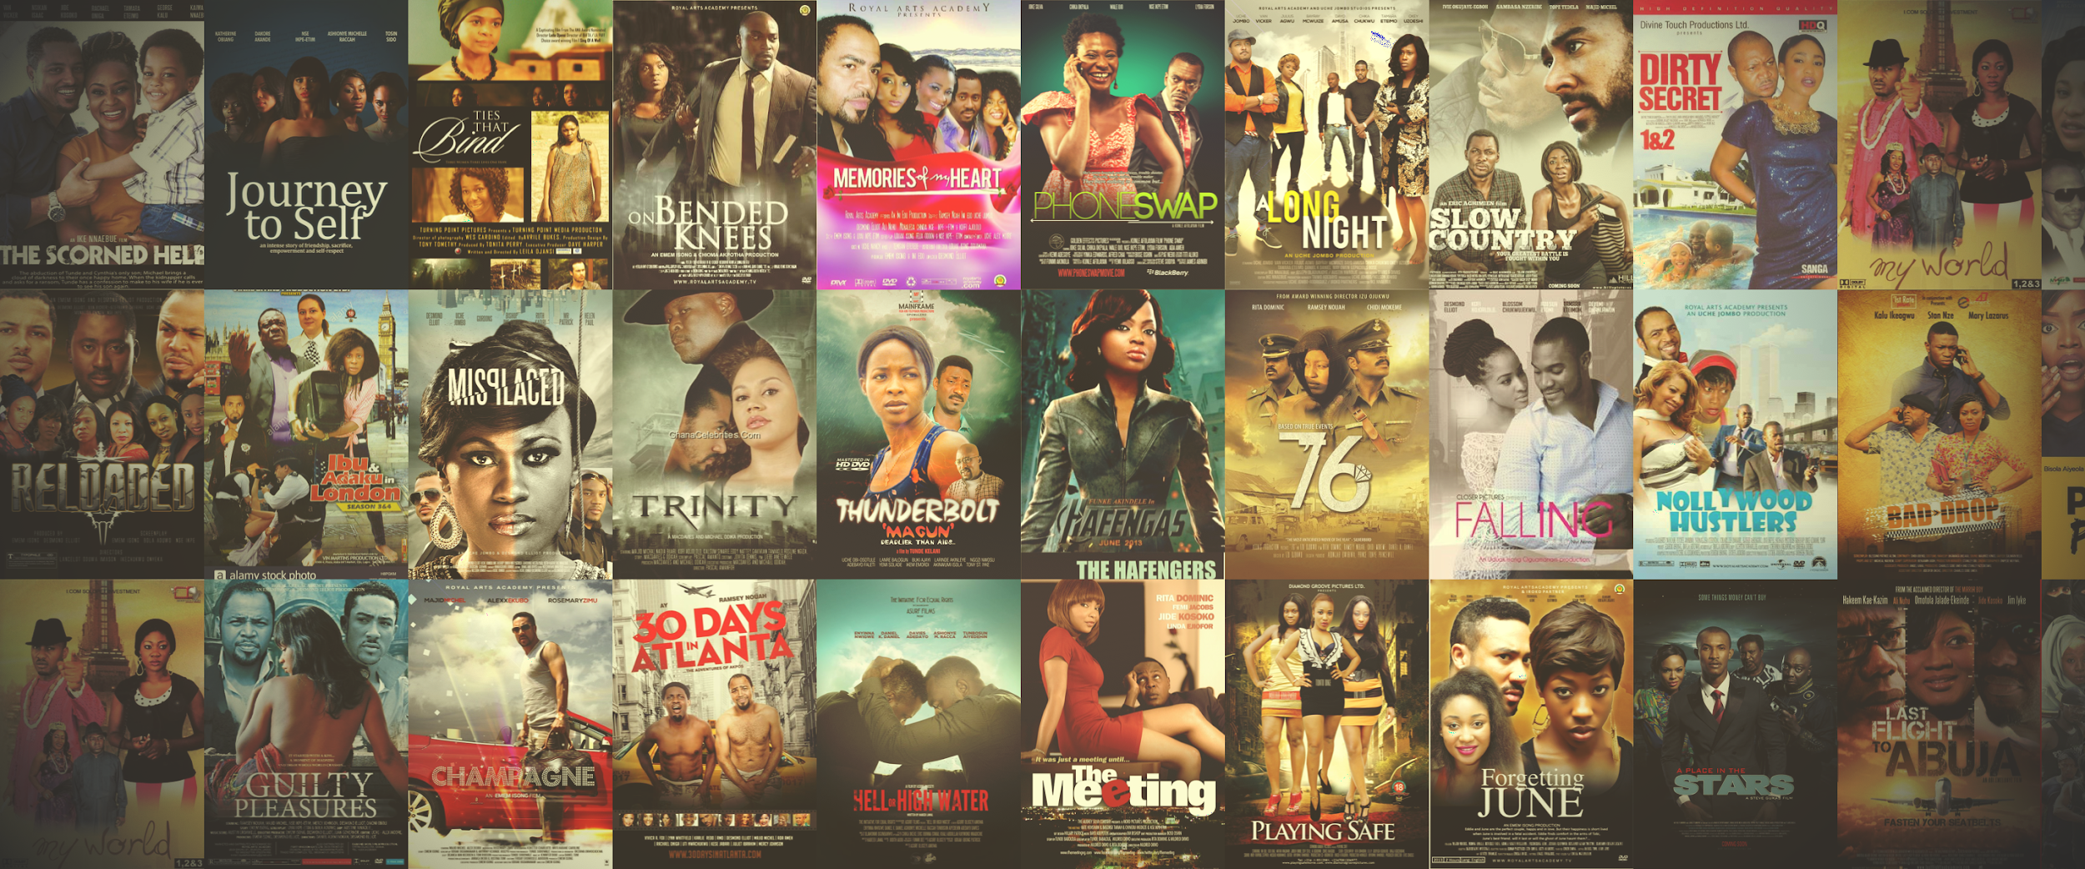
https://www.africainnovationsummit.com/blog-view?id=1

Slide 20
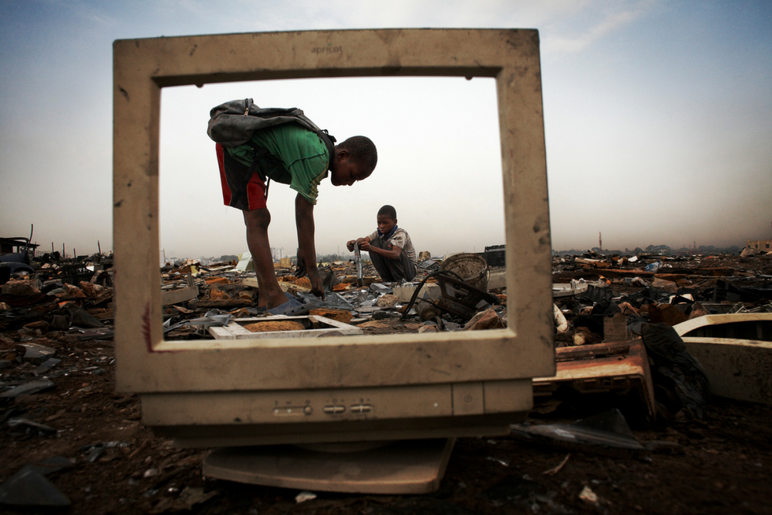
https://www.rubiconglobal.com/blog/electronic-waste-problem/

Slide 21
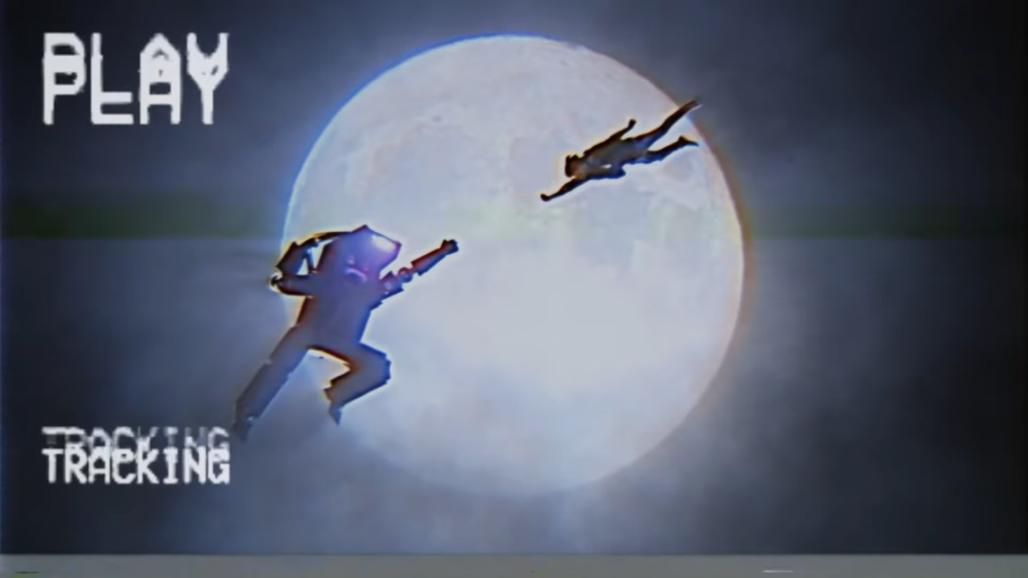
Kung Fury (2015)

Slide 22
Kung Fury (2015)

Slide 23
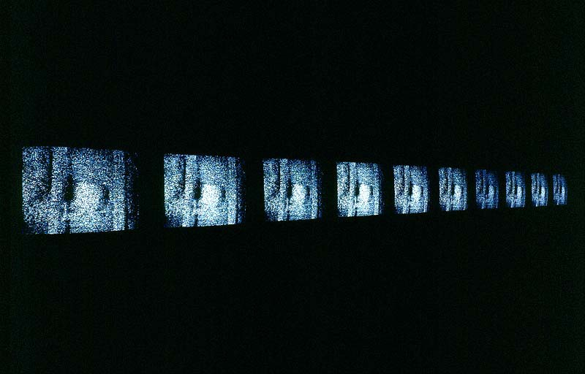
Kjell Bjørgeengen, Shift II (1995) © Bjørgeengen, Kjell/BONO

Slide 24
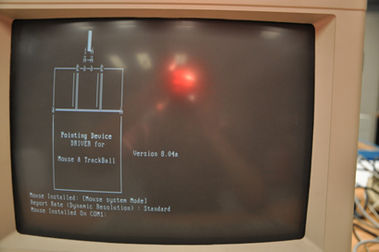
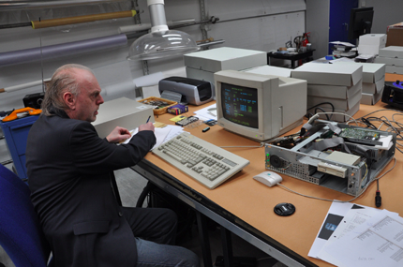
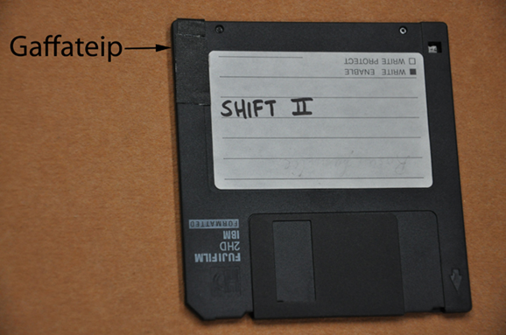
Conservation of Kjell Bjørgeengen, Shift II (1995) © Nasjonalmuseet

Slide 25
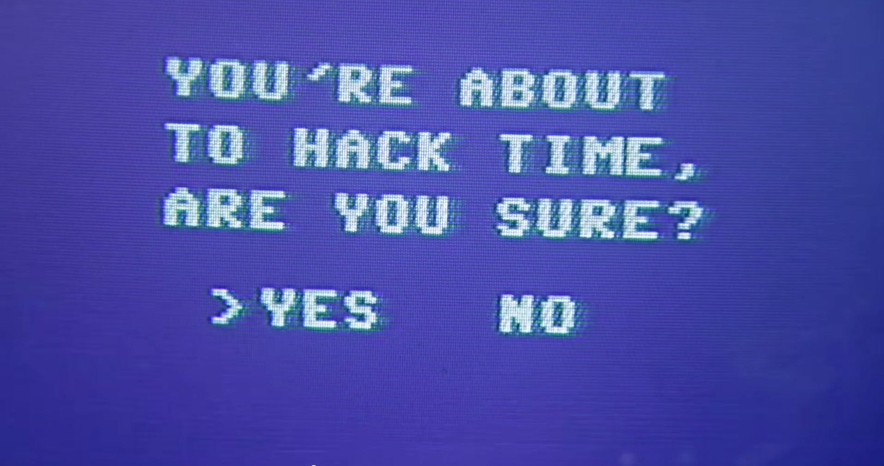
Kung Fury (2015)
Notes:
Future - past

Slide 26
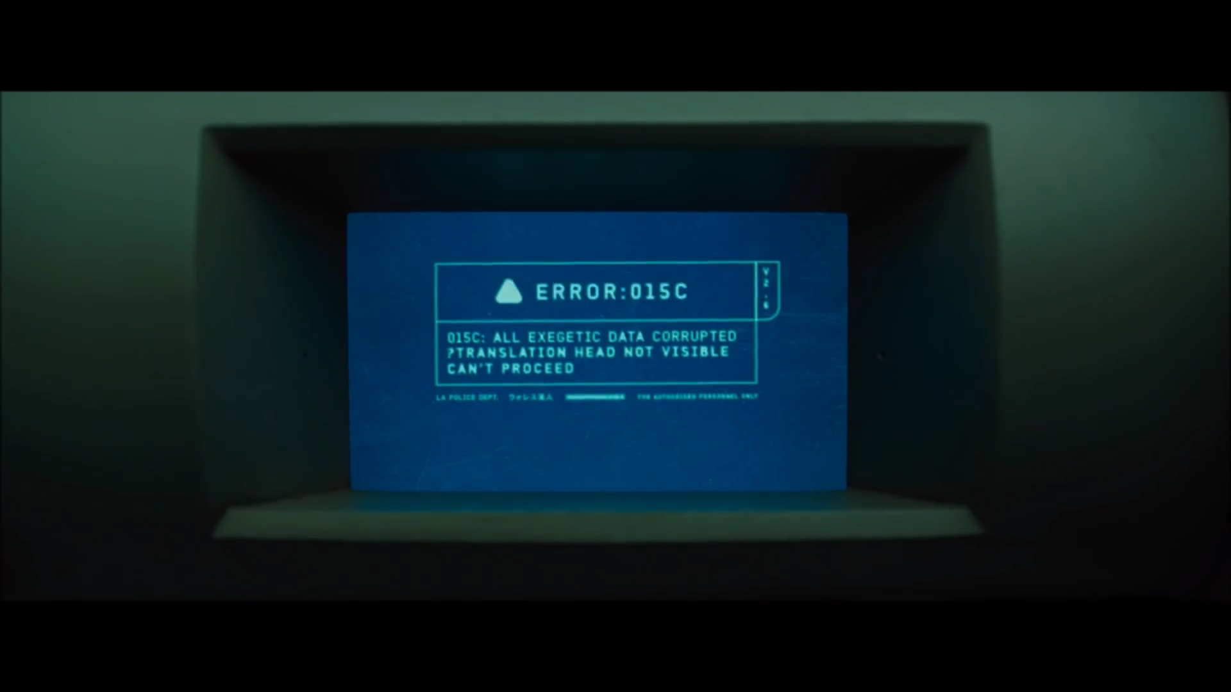

Slide 27
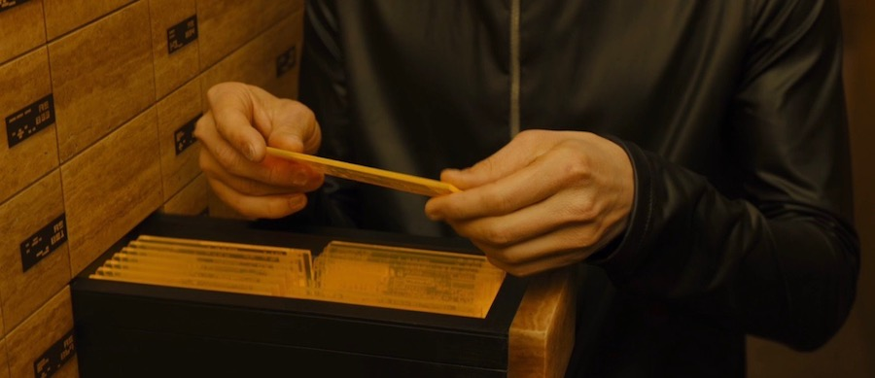
Blade Runner 2049 (2017)

Slide 28
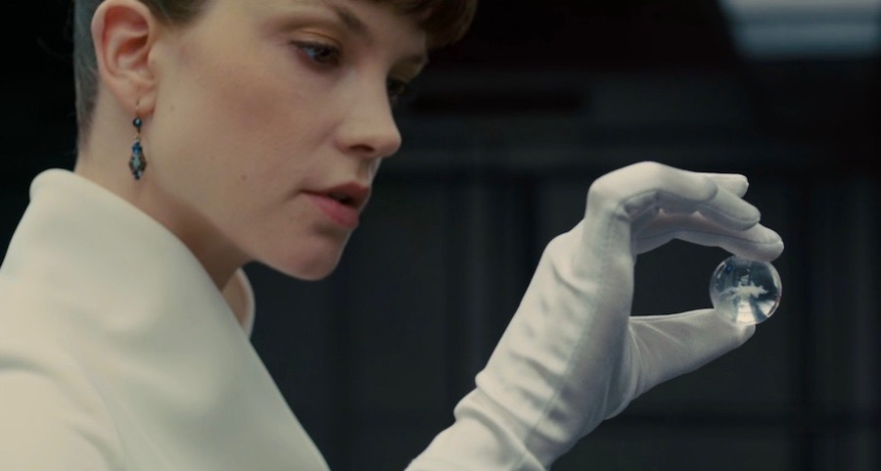
Blade Runner 2049 (2017)

Slide 29
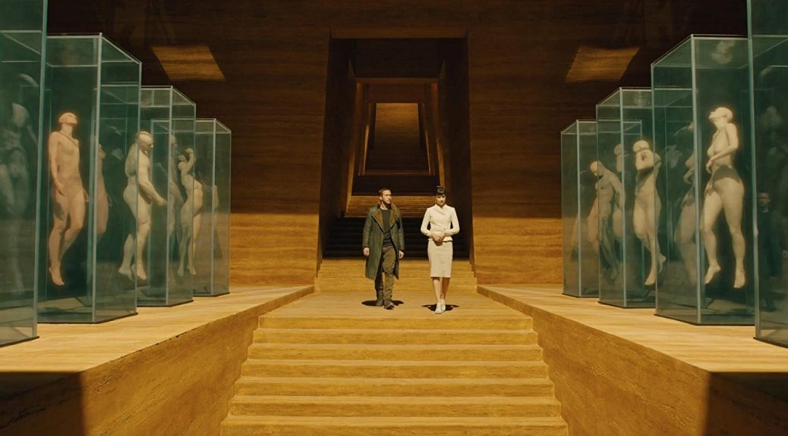

Slide 30
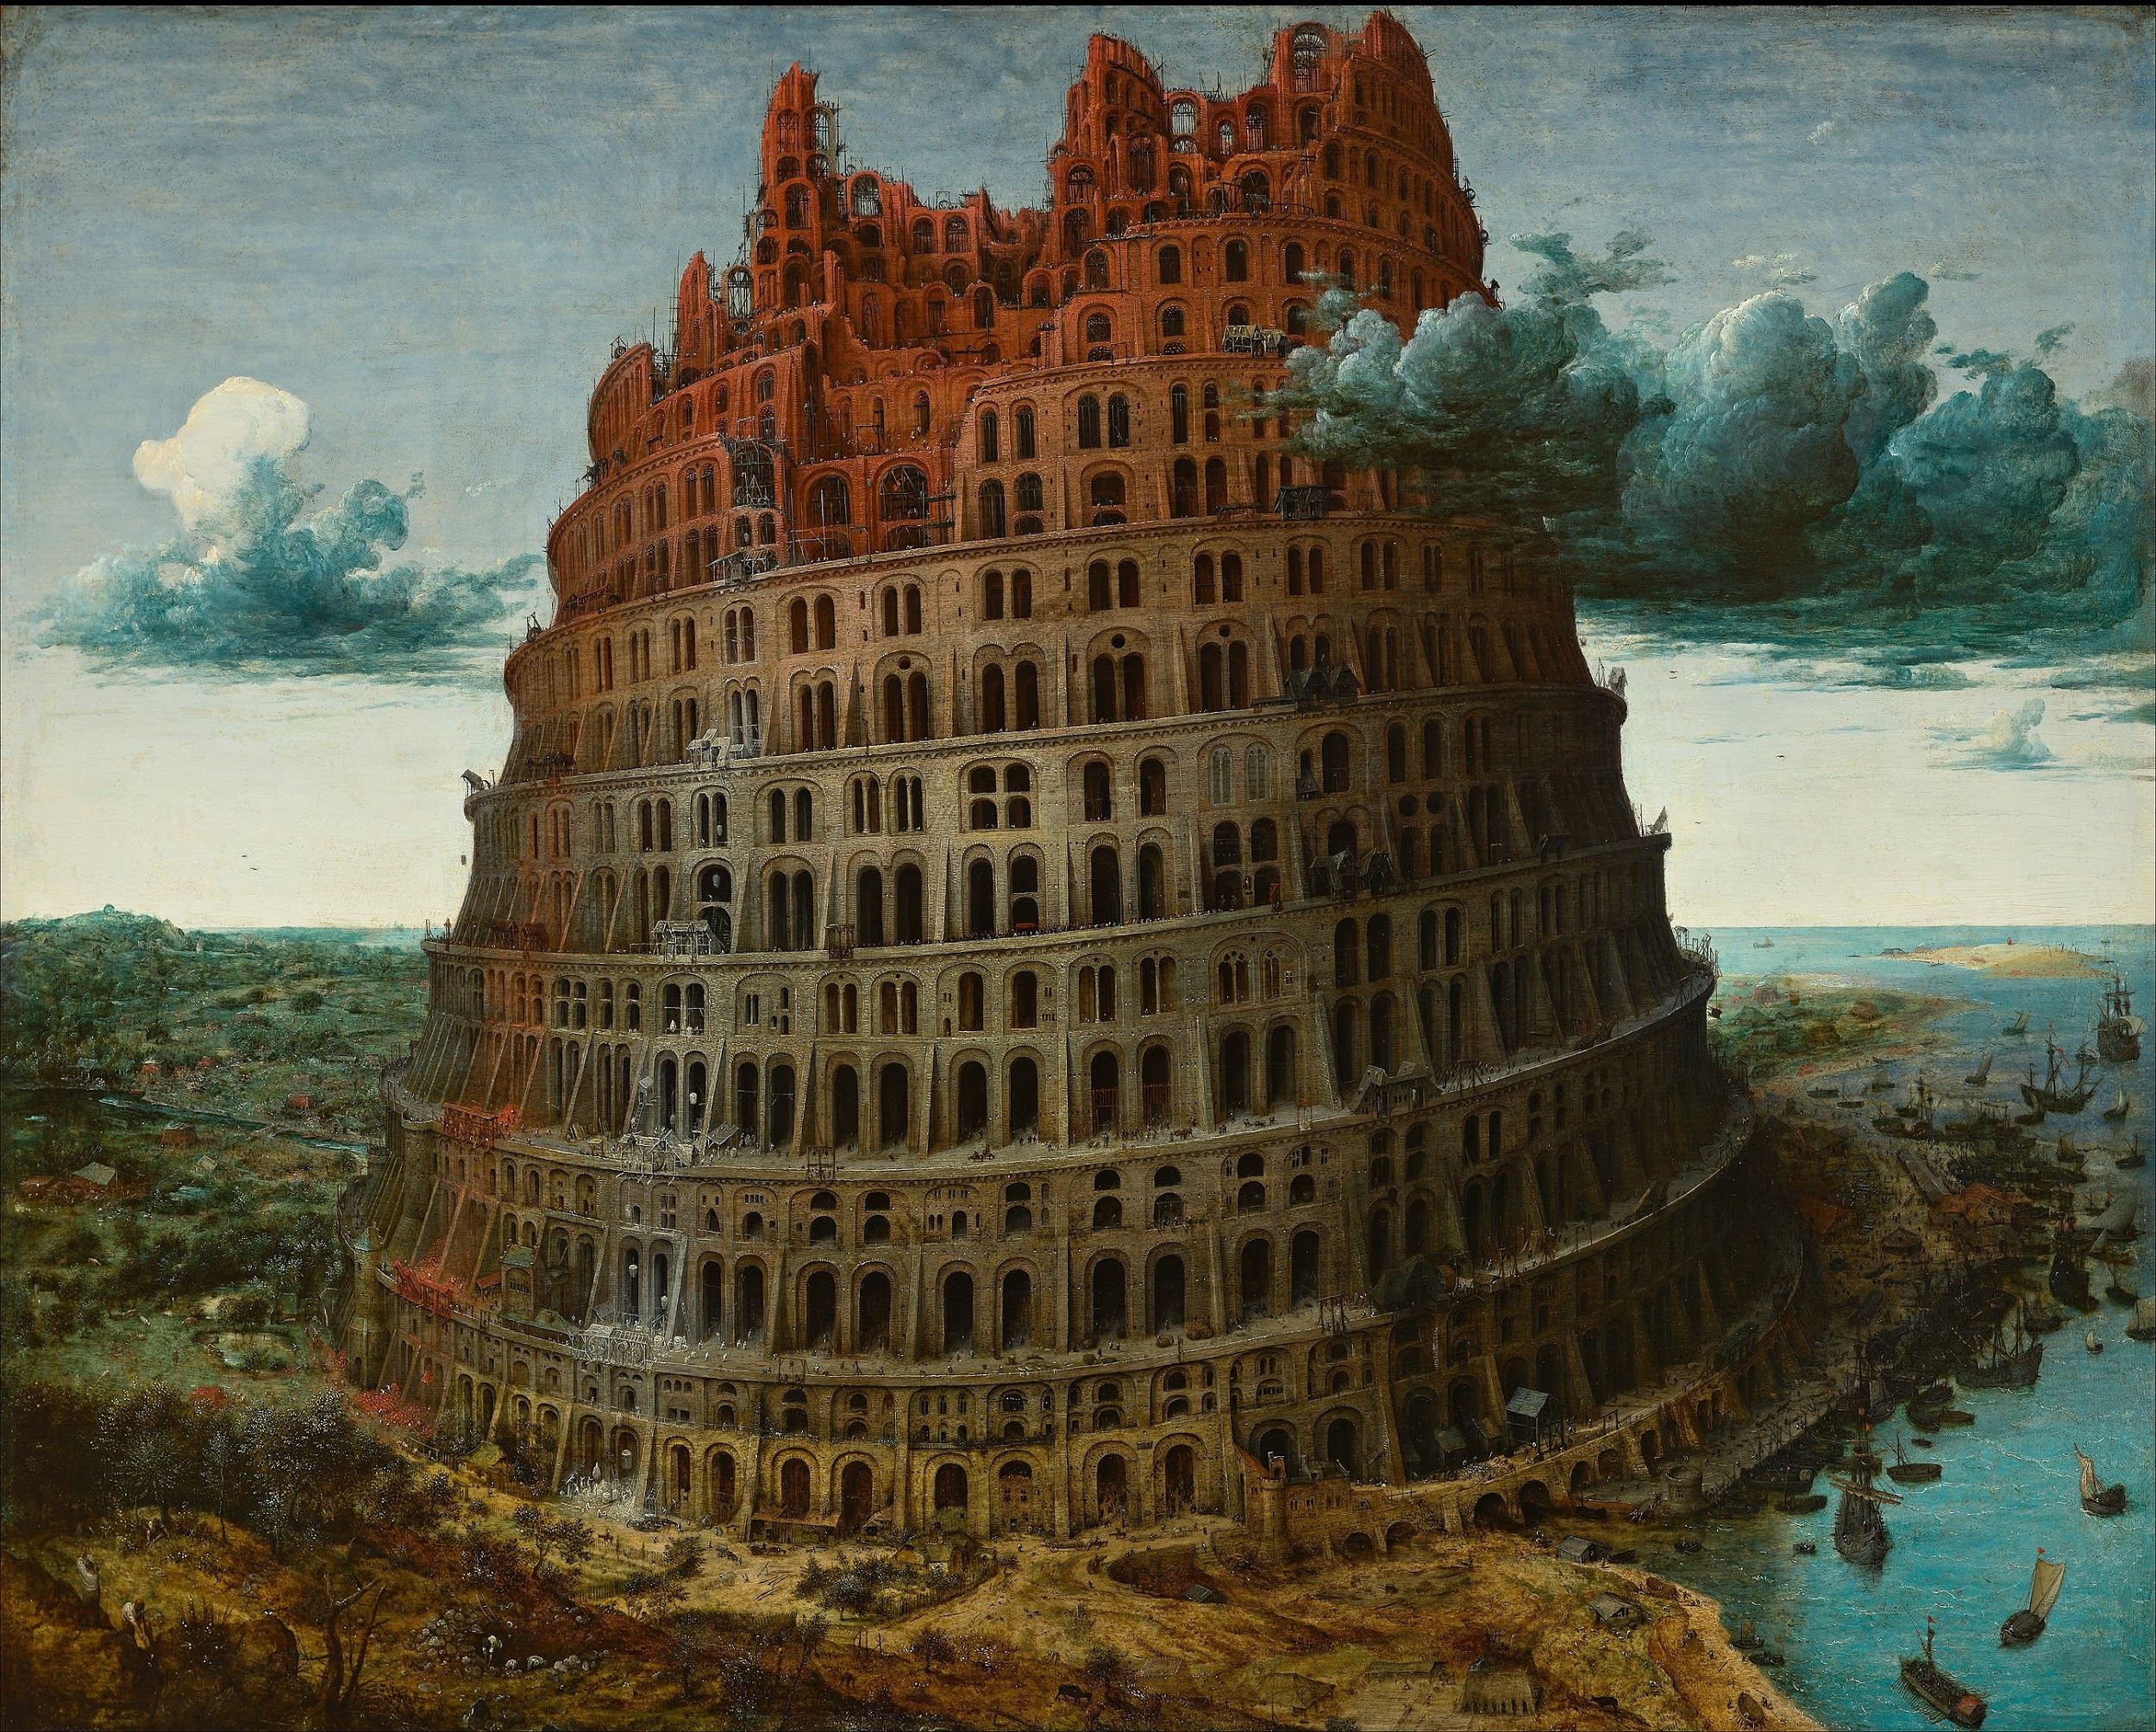

Slide 31
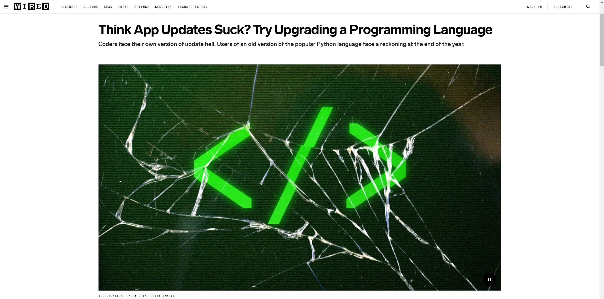
https://www.wired.com/story/think-app-updates-suck-try-upgrading-programming-language/

Slide 32
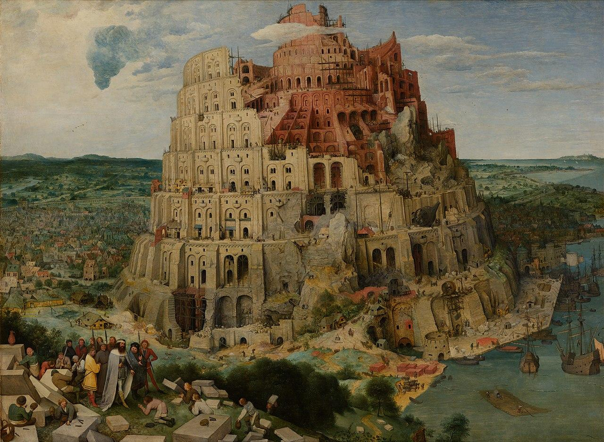
Notes:
File:Pieter Bruegel the Elder - The Tower of Babel (Vienna) - Google Art Project - edited.jpg
Created: 1563date QS:P571,+1563-00-00T00:00:00Z/9

Slide 33
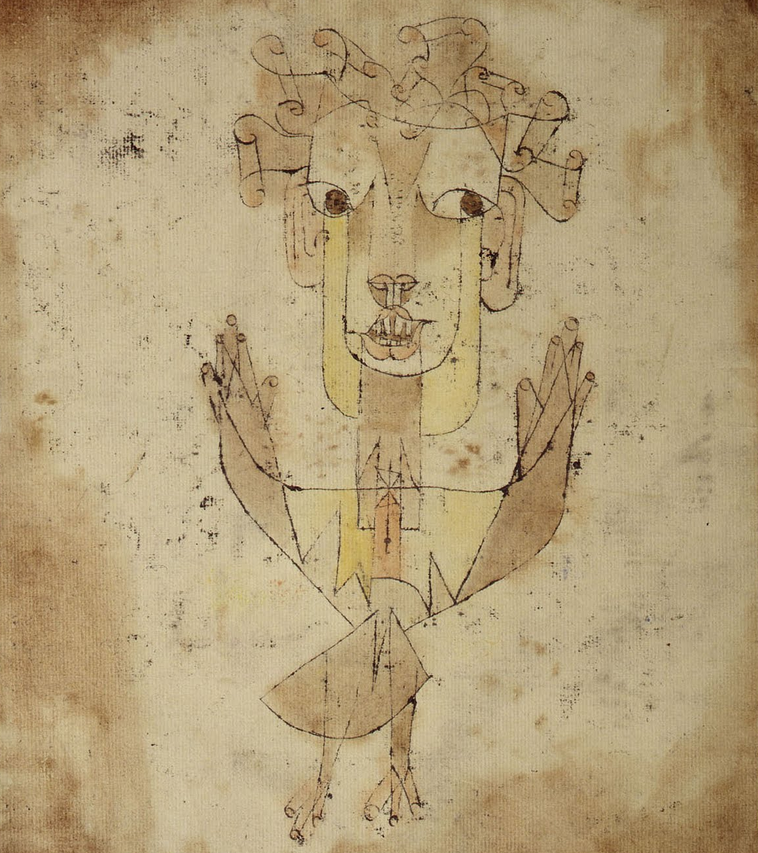
His face is turned toward the past. Where we perceive a chain of events, he sees one single catastrophe which keeps piling wreckage upon wreckage and hurls it in front of his feet. The angel would like to stay, awaken the dead, and make whole what has been smashed. But a storm is blowing from Paradise; it has got caught in his wings with such violence that the angel can no longer close them. The storm irresistibly propels him into the future to which his back his turned, while the pile of debris before him grows skyward. The storm is what we call progress.
- Benjamin, Walter. "On the concept of history." (2009): 389.
Paul Klee, Angelus Novus (1921)

Slide 34
Thank You!
Jina Chang • Nasjonalmuseet • 06.12.2019

